Slide 1
Norlin Walk
Aiden Bohenick, Jeong Min Lee, Dalton Morrow, Michael Tang, Owen Wattenmaker

Slide 2


NorlinWalk

Slide 3
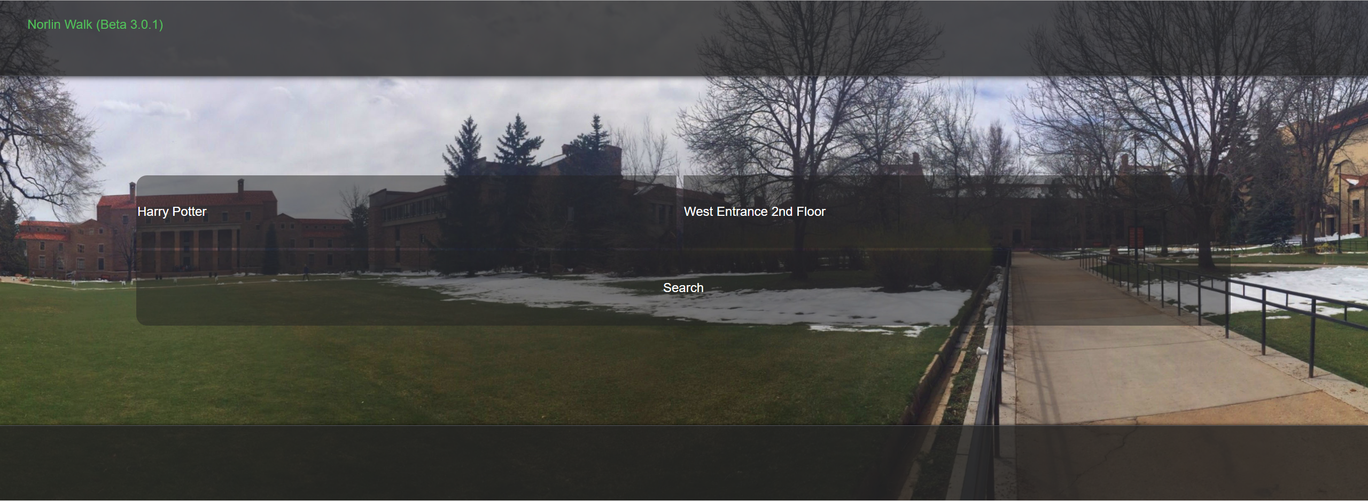
Norlin Walk
Type in a book
Select a starting position
Follow the arrows

Slide 4


Tools Used
Purpose | Tool | Rating
Project Tracker | Github
VCS Repository | Github
Database
Testing
Auto-Documenter
Deployment Environment | Heroku

Slide 5
Methodology
Agile
Peer Review

Slide 6
Challenges

Slide 7
Demo

